Slide 1
WORLD HAPPINESS REPORT 2019 ANALYSIS
BY
ANUP SAMUEL

Slide 2
WORLD HAPPINESS REPORT
Annual publication of the UN Sustainable Development Solutions Network.
First released in 2012, with subsequent releases every year.
Based on the gross national happiness indicator of the Kingdom of Bhutan, which has used happiness instead of GDP as the main development indicator.
https://en.wikipedia.org/wiki/World_Happiness_Report

Slide 3
METHODOLOGY
Rankings based on a Cantril ladder survey; respondents asked to think of a ladder with the best possible life being a 10 and worst 0.
Report correlates results with various life factors.
Contains analysis from experts who analyze the correlation between measurements of well-being and the overall progress of nations.
The 2019 report averages the happiness score from 2016-18 and ranks 156 nations with Finland at the top and South Sudan at the bottom.

Slide 4
CRITERIA FOR RANKING
CRITERIA | BEST COUNTRY | WORST COUNTRY
GDP Per Capita | Qatar | Somalia
Social Support | Iceland | Central African Republic
Healthy life expectancy | Singapore | Eswatini
Freedom to make choices | Uzbekistan | Afghanistan
Generosity | Myanmar | Greece
Perceptions of corruption | Singapore | Moldova

Slide 5
ANALYSIS USING PYTHON

Slide 6
STEPS
Load the dataset and check for null values.
Dropping unnecessary features like the country name and rank.
Defining the ‘Score’ feature as the target and the other columns as features.
Need to understand the impact of the 6 parameters on the Score variable.
Splitting dataset into testing, validation and training sets using sklearn (80/10/10 split).

Slide 7


STEPS..
Performing 5-fold cross validation and checking scores using Random Forest.
Performing hyperparameter tuning using GridSearchCV to find best parameters.
Fitting and evaluating best model on the validation set using accuracy, precision and recall scores.
Evaluating the model on the test set.

Slide 8
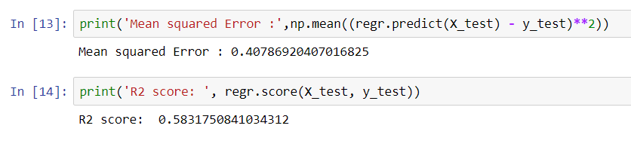
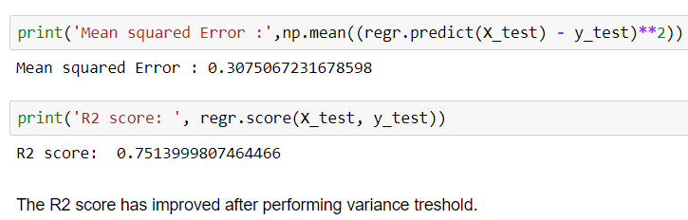
STEPS..
Performing linear regression and calculating the mean squared error and R2 score.
Performing Variance Threshold with a threshold value of 0.8 with an aim to improve the R2 score.
By removing features whose variance doesn’t meet the threshold.

Slide 9
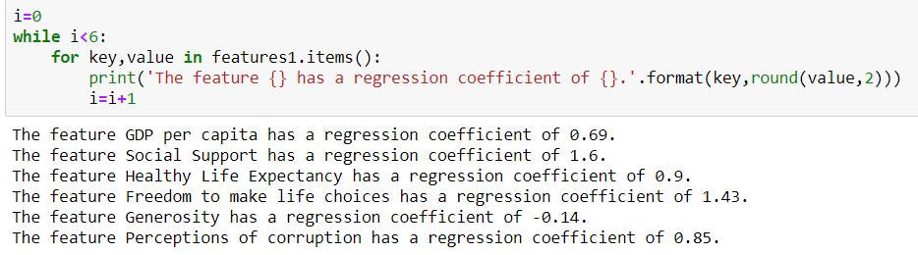
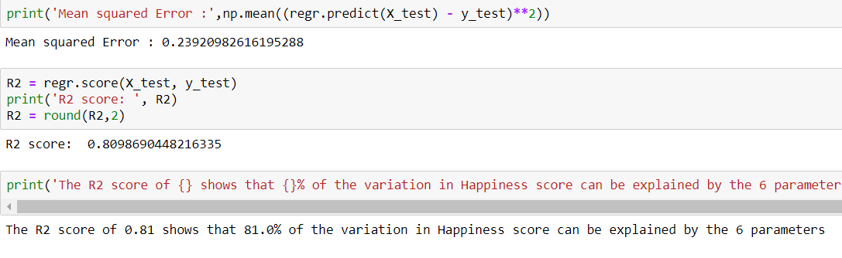
STEPS..
Performing Recursive Feature Elimination(RFE) by pruning away less important features till the desired number of features are obtained.
Measuring the regression coefficient of each parameter.
Calculation of R2 score again.

Slide 10
GRAPHICAL ANALYSIS

Slide 11
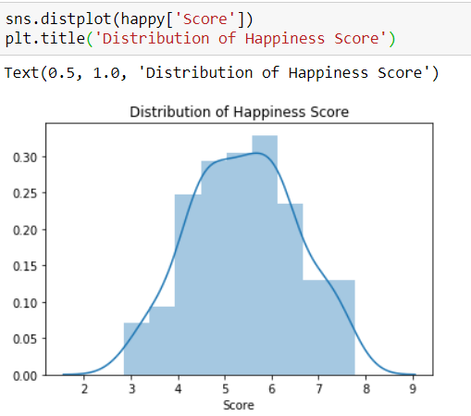

Slide 12
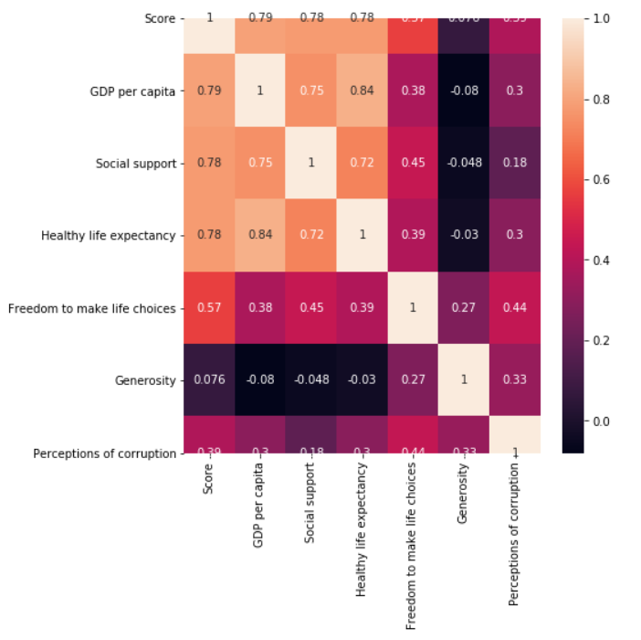
CORRELATION HEATMAP

Slide 13
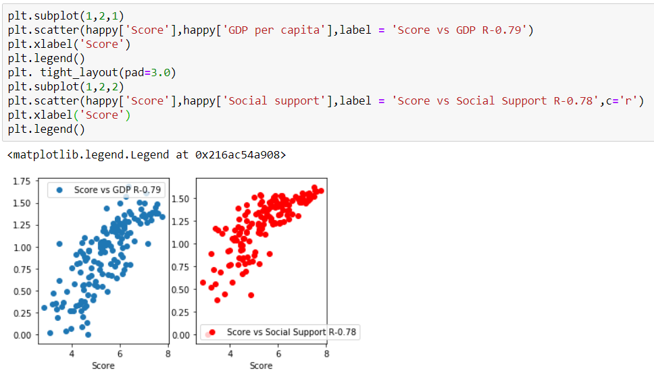

Slide 14
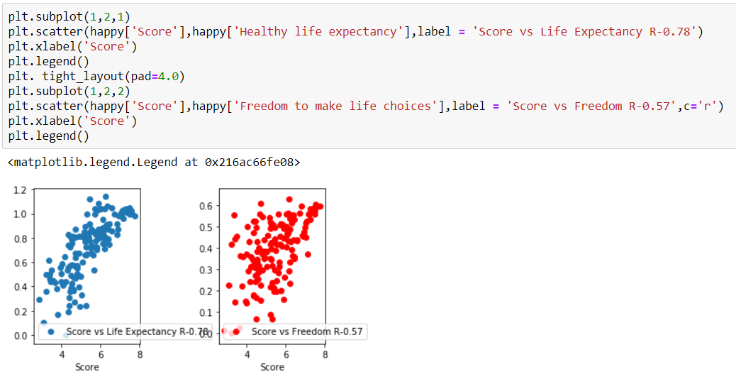

Slide 15
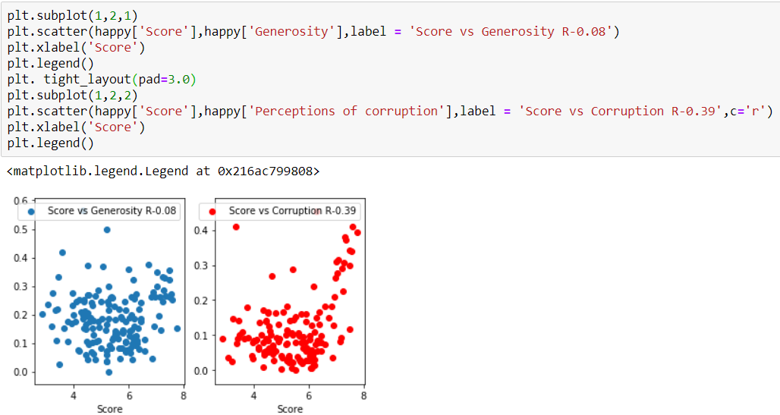

Slide 16
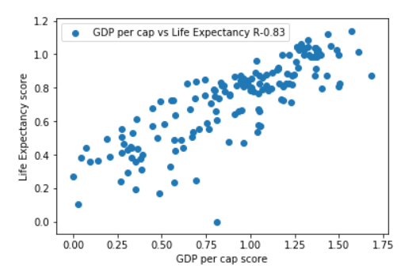
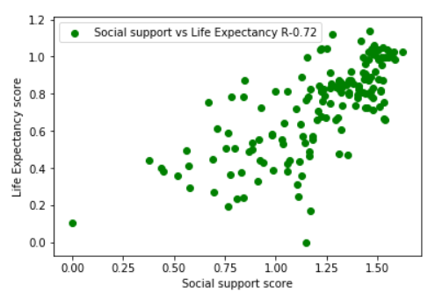

Slide 17
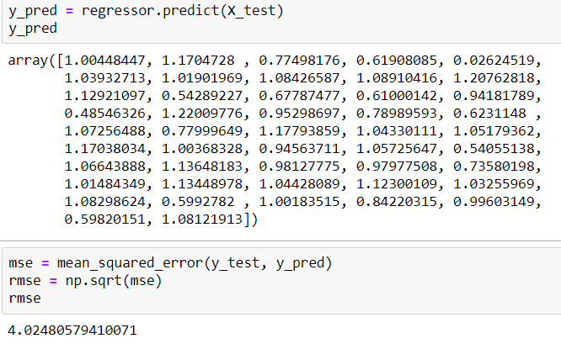
SUPPORT VECTOR REGRESSION (SVR)
Normalize the data using standard scaler.
Fitting the normalized data to the SVR regressor.
Predicting the values of y_test and calculating the root mean square error value.

Slide 18
ANALYSIS BY CONTINENT
https://www.visualcapitalist.com/visualizing-the-happiest-country-on-every-continent/

Slide 19
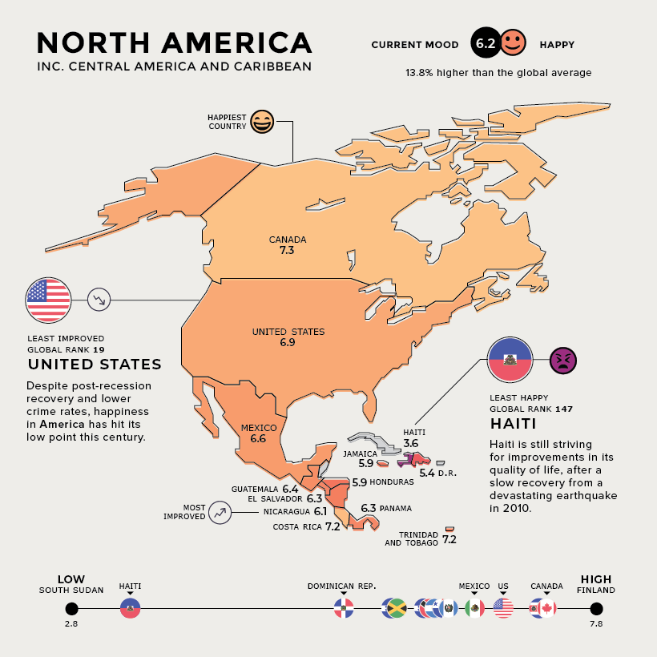

Slide 20
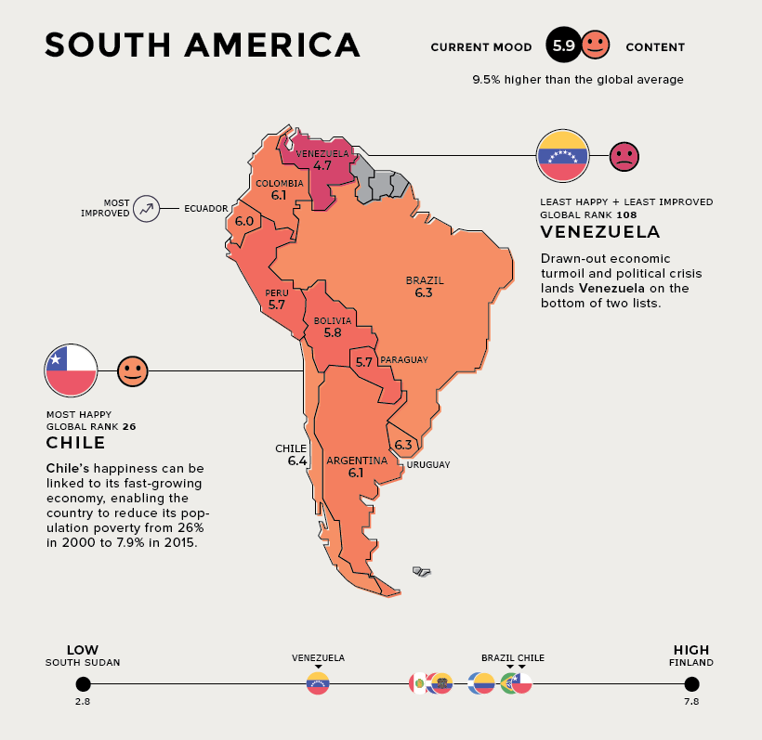

Slide 21
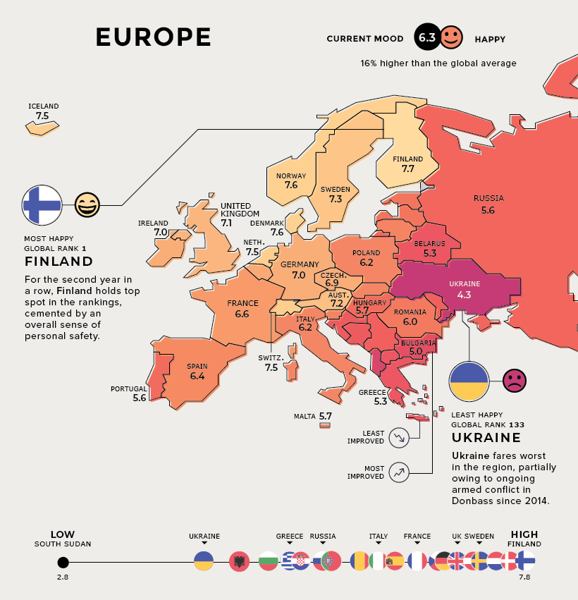

Slide 22
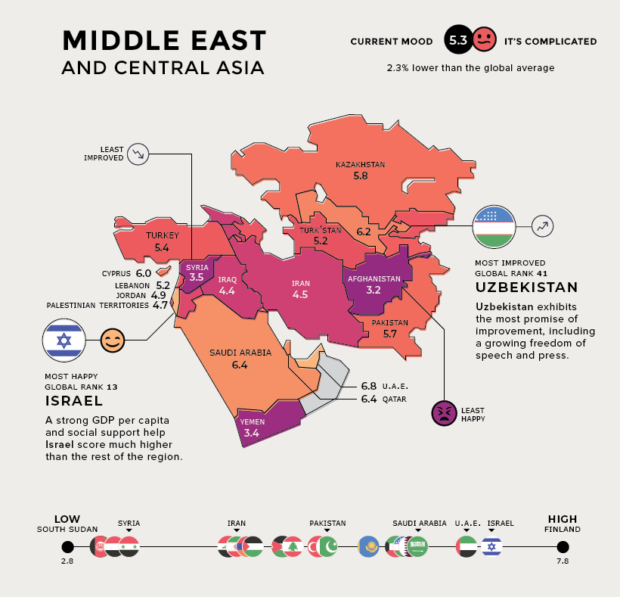

Slide 23
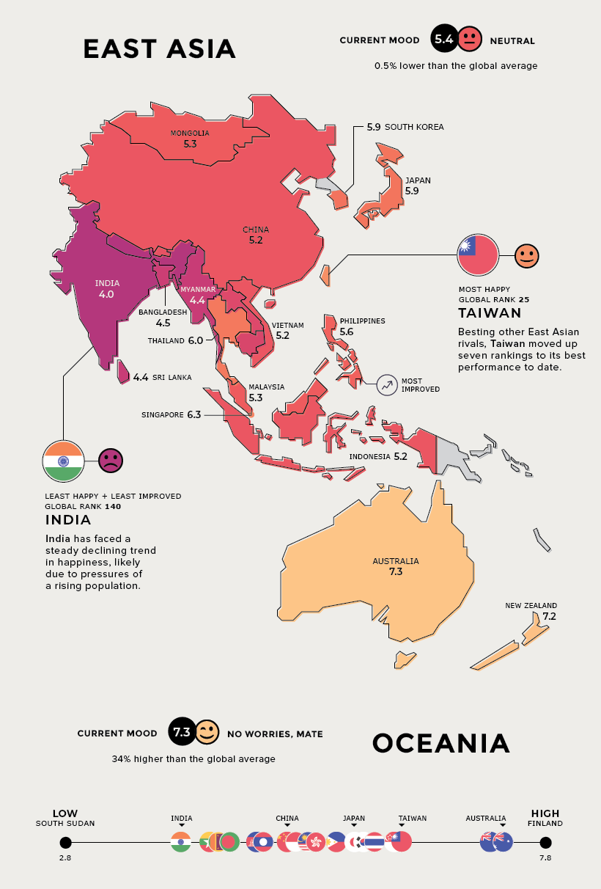

Slide 24
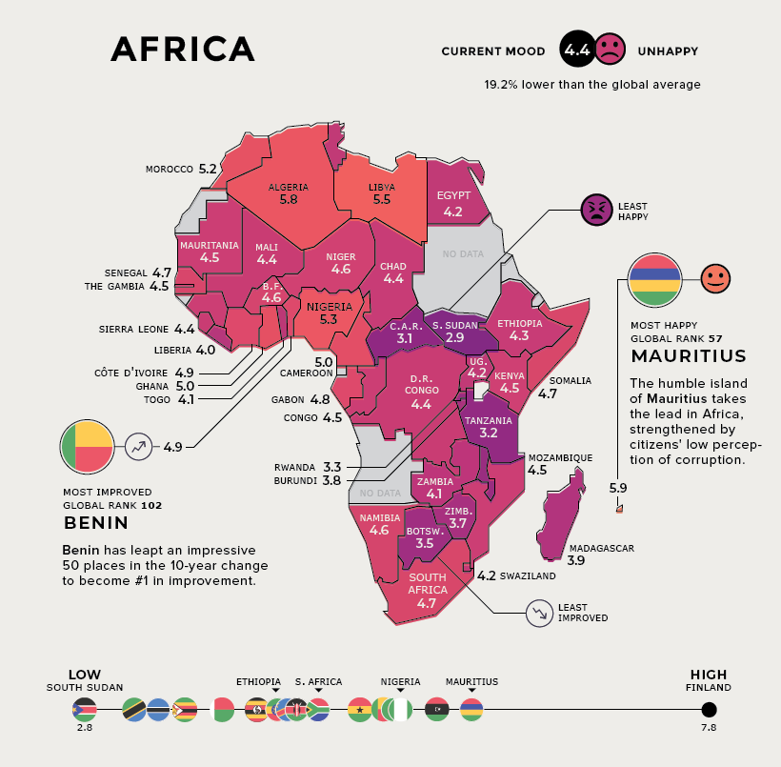

Slide 25
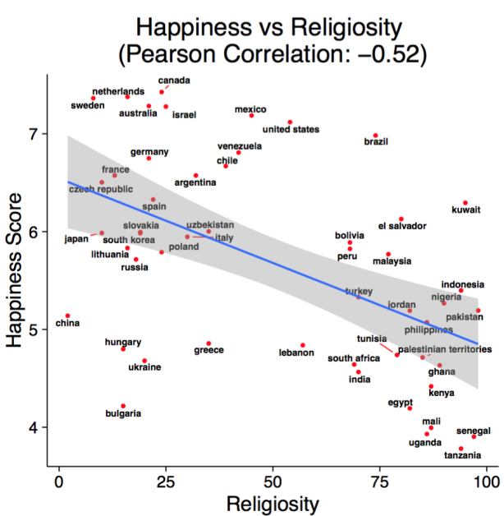
https://whyevolutionistrue.wordpress.com/2016/02/01/happiness-versus-religiosity/

Slide 26
THANK YOU

